Slide 1
An Introduction to Stochastic Actor-Oriented Models (SAOM or SIENA)
Dr. David R. Schaefer
University of California, Irvine
Duke Social Networks & Health Workshop, 2018

Slide 2
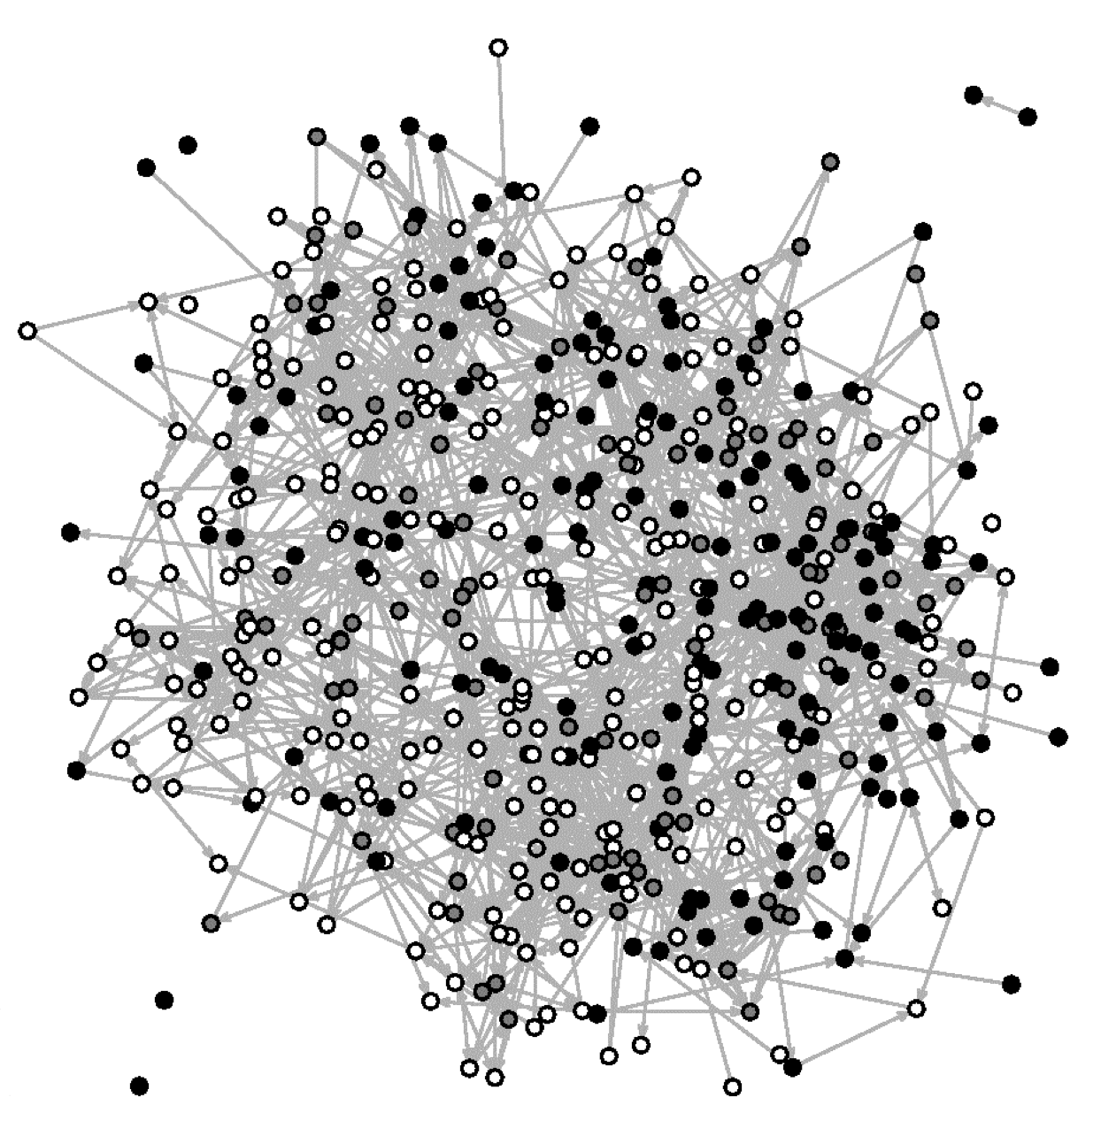
Jefferson High (Add Health)
Smokers popular:
Smoking-indegree correlation = .09*
Smoking homophily:
Odds ratio = 1.57***
30-day smoking
 | None (0)
 | 1-11 days (1)
 | 12+ days (2)

Slide 3
Network Homogeneity on Smoking
time t-1
Peer Influence
A
B
time t
C
D
A
B
or
Friend Selection
C
D
A
B
C
D
Notes:
We observe homophily at time t, which is consistent with peer influence, but this could also be due to friend selection.
Not shown: could also be selecting into a common context creates homogeneity

Slide 4
Smoking-Related Popularity
time t-1
Popularity leads to smoking
A
B
time t
C
D
A
B
or
Smoking enhances popularity
C
D
A
B
C
D
Notes:
We observe a popular smoker at time t, but what preceded it?

Slide 5
Inferring Network → Behavior
Requires controlling for network selection based on the behavior (e.g., popularity, homophilous selection)
In modeling the network, also good to account for
Similarity on attributes correlated with the behavior
Network processes (e.g., triad closure) that drive network change & can amplify network-behavior patterns (see below)
I 
Homophily
Homophily
through
Reciprocity
Homophily
through
Transitivity
A
B
A
B
A
B
C
D
C
D
C
D

Slide 6
When to use a SAOM
Questions about how networks affect individual “behaviors”
Peer influence
Diffusion
Questions about changes in network structure over time
Social exclusion and withdrawal
How do we acquire the networks who influence us?
Questions about endogenous associations between networks and behavior (and subsequent impacts)
Cumulative disadvantage process
Notes:
New model specification

Slide 7
How do SAOMs relate to other models?
 | Modeled Interdependencies between Individuals
 | None | w/in Dyad | Dyad+
Individual Attribute | General Linear Model | Actor-Partner Interdependence (APIM) | Network Autoregression | Stochastic Actor-Oriented Model (SAOM)
Network | Erdös-Renyi | (MR)QAP, Dyad Independent Model | ERGM, Relational Event Model
Outcome
Figure adapted from jimi adams

Slide 8
ERGM and SIENA Distinction
Dynamic ERGM (e.g., TERGM, STERGM)
Models X_{t} as a function of X_{t-1}
Discrete change in network
SIENA
Conditional on X_{t-1}, assume sequence of unobserved micro-steps to X_{t}
A micro-step allows one actor to change one tie
Model estimates the “rules” actors use to determine which tie to change
Ultimately, actors following these rules produce a network resembling X_{t}
For more details see: https://osf.io/preprints/socarxiv/6rm9q

Slide 9
Overview of Model Presentation
The general form of the model
Network function for relationship change
Behavior function for “behavior” change
Rate functions
Model estimation procedure
Model assumptions
MCMC estimation algorithm
Goodness of Fit
Empirical example
Extensions & Miscellany

Slide 10
Switch to “SIENA intuition.R”

Slide 11
1. General SAOM Form

Slide 12
Stochastic Actor-Oriented Model
Also called Stochastic Actor-Based Model (SABM), or “SIENA” based on the software used to estimate the model
Simulation Investigation for Empirical Network Analysis
Currently estimable in R (RSiena)
Recognition that networks and behavior are interdependent
Behaviors can affect network structure
Network structure can affect behavior
Thus, both “outcomes” are endogenous

Slide 13
SAOM Effects
Endogenous Network Effects
Social Influence on Behavior (Smoking)
Network
Individual/ Contextual
Attributes
Behavior
(Smoking)
Network Selection based on Behavior (Smoking)
Notes:
Network and Behavior are both outcomes in the model.

Slide 14
SAOM Components
Discrete change is modeled as occurring in continuous time (between observations) through a sequence of micro steps
Model takes the form of an AGENT-BASED MODEL
Actors control their outgoing ties and behavior
Functions specify when and how they change
 | Decision Timing (when changes occur) | Decision Rules (how changes occur)
Network Evolution | Network rate function | Network objective function
Behavior Evolution | Behavior rate function | Behavior objective function
Notes:
1. Rate functions determine
Which actor makes a change
Whether change is to network or behavior
2. Objective functions determine which change is made
Consider all possible ties/behavior change
Make change that maximizes objective function

Slide 15
Network Objective Function
Network change is modeled by allowing actors to select ties (by adding or dropping them) based upon:
f_{i}(β,x) is the value of the network objective function for actor i, given:
the current set of parameter estimates (β)
state of the network (x)
For k effects, represented as s_{ki}, which may be based on
the network (x), or individual attributes (z)
Estimated with random disturbance (ε) associated with x, z, t and j
Goal of model fitting is to estimate each β_{k}

Slide 16
Network Decision
During a micro step, an actor evaluates how changing its outgoing
tie in each dyad would affect the value of the objective function
(goal is to maximize the value of the function)
j₁
j₂
outdegree
reciprocity
ego
j₃
If… | outdegree | reciprocity | sum
No change | -2 * 2 = -4 | 1.8 * 1 = 1.8 | -2.2
Drop j₁ | -2 * 1 = -2 | 1.8 * 0 = 0 | -2
Drop j₂ | -2 * 1 = -2 | 1.8 * 1 = 1.8 | -.2
Add j₃ | -2 * 3 = -6 | 1.8 * 2 = 3.6 | -2.4
Add j₄ | -2 * 3 = -6 | 1.8 * 1 = 1.8 | -4.2
j₄
 | ego | j₁ | j₂ | j₃ | j₄
ego | - | 1 | 1 | 0 | 0
j₁ | 1 | - | 0 | 0 | 0
j₂ | 0 | 0 | - | 0 | 0
j₃ | 1 | 0 | 0 | - | 0
j₄ | 0 | 0 | 0 | 0 | -
Given the current state of the network, ego is
most likely to drop the tie to j₂, because that
decision maximizes the objective function

Slide 17
Network Objective Function Effects
Outdegree always present
Network processes (e.g., reciprocity, transitivity)
Attribute based:
Sociality: effect of attribute on outgoing ties
Popularity: effect of behavior on incoming ties
Homophily: ego-alter similarity
Note: attributes may be stable or time-changing (exogenous or endogenously modeled)
Dyadic attributes (e.g., co-membership)

Slide 18
Behavior Objective Function
Predict change in “behavior,” which is the generic term for an individual attribute
Refers to any attitude, belief, health factor, etc.
Optional: SAOMs don’t require one and they’re not relevant for many questions
Ordinal measurement required (~2-10 levels best)
Goal is to estimate effect of network on behavior change

Slide 19
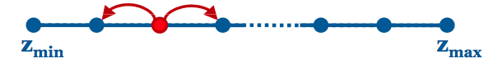
Behavior Objective Function
Choice probabilities take the form of a multinomial logit model instantiated by the objective function
where z represents the behavior
The function dictates which level of the behavior actors adopt
Actors evaluate all possible changes
Increase/decrease by one unit, or no change
Option with highest evaluation most likely
Figure adapted from C. Steglich

Slide 20
Behavior Objective Function Effects
Linear term to control for distribution (quadratic term if the behavior has 3+ levels)
Predictors of peer influence
Alters’ value on the behavior, or another attribute or behavior
Multiple specifications, including mean, minimum, maximum…
Ego’s other behaviors or attributes (e.g., gender, age)
Ego’s network position (e.g., degree)
Interactions with reciprocity

Slide 21
Behavior Decision
Linear effect
Attribute effect (e.g. age)
Quadratic effect
Similarity effect
How attractive is each level of the behavior based on these effects and (hypothetical) parameter estimates?

Slide 22
Behavior Decision*
If… | linear | quad | age | similarity | sum
Drop to 0 | -.5 * 0 = 0 | .25 * 0 = 0 | .1 * 10 * 0 = 0
Stay at 1 | -.5 * 1 = -.5 | .25 * 1 = .25 | .1 * 10 * 1 = 1
Up to 2 | -.5 * 2 = -1 | .25 * 4 = 1 | .1 * 10 * 2 = 2
The contributions for these effects are simple to calculate
* For simplicity, calculations treat covariates as uncentered. However, SIENA will center dependent behaviors,
thus for actual computations replace raw values in calculations with centered values.

Slide 23
Behavior Decision*
Calculate total similarity for each of ego’s possible decisions
=
where
= similarity expected by chance = .05
J₁(1)
Maintain z=1
j₂(1)
Ego, j₁ | 1 - | 1 - 1 | / 2 = 1 | 1 (1 - .05) = .95
Ego, j₂ | 1 - | 1 - 1 | / 2 = 1 | 1 (1 - .05) = .95
Ego, j₃ | 1 - | 1 - 0 | / 2 = .5 | 0 (.5 - .05) = 0
Ego, j₄ | 1 - | 1 - 2 | / 2 = .5 | 0 (.5 - .05) = 0
 |  | Similarity statistic = 1.90
Ego (1)
J₃(0)
J₄(2)
* For simplicity, calculations treat covariates as uncentered. However, SIENA will center dependent behaviors,
thus for actual computations replace raw values in calculations with centered values.

Slide 24
Behavior Decision*
Calculate total similarity for each of ego’s possible decisions
=
where
= similarity expected by chance = .05
J₁(1)
Decrease to z=0
j₂(1)
Ego, j₁ | 1 - | 0 - 1 | / 2 = .5 | 1 (.5 - .05) = .45
Ego, j₂ | 1 - | 0 - 1 | / 2 = .5 | 1 (.5 - .05) = .45
Ego, j₃ | 1 - | 0 - 0 | / 2 = 1 | 0 (1 - .05) = 0
Ego, j₄ | 1 - | 0 - 2 | / 2 = 0 | 0 (0 - .05) = 0
 |  | Similarity statistic = .90
Ego (1)
J₃(0)
J₄(2)
* For simplicity, calculations treat covariates as uncentered. However, SIENA will center dependent behaviors,
thus for actual computations replace raw values in calculations with centered values.

Slide 25
Behavior Decision*
Calculate total similarity for each of ego’s possible decisions
=
where
= similarity expected by chance = .05
J₁(1)
Increase to z=2
j₂(1)
Ego, j₁ | 1 - | 2 - 1 | / 2 = .5 | 1 (.5 - .05) = .45
Ego, j₂ | 1 - | 2 - 1 | / 2 = .5 | 1 (.5 - .05) = .45
Ego, j₃ | 1 - | 2 - 0 | / 2 = 0 | 0 (0 - .05) = 0
Ego, j₄ | 1 - | 2 - 2 | / 2 = 1 | 0 (1 - .05) = 0
 |  | Similarity statistic = .90
Ego (1)
J₃(0)
J₄(2)
* For simplicity, calculations treat covariates as uncentered. However, SIENA will center dependent behaviors,
thus for actual computations replace raw values in calculations with centered values.

Slide 26
Behavior Decision*
If… | linear | quad | age | similarity | sum
Drop to 0 | -.5 * 0 = 0 | .25 * 0 = 0 | .1 * 10 * 0 = 0 | 1 * .90 = .90 | .90
Stay at 1 | -.5 * 1 = -.5 | .25 * 1 = .25 | .1 * 10 * 1 = 1 | 1 * 1.90 = 1.90 | 2.65
Up to 2 | -.5 * 2 = -1 | .25 * 4 = 1 | .1 * 10 * 2 = 2 | 1 * .90 = .90 | 3.90
Finally, calculate the contribution of each possible decision
* For simplicity, calculations treat covariates as uncentered. However, SIENA will center dependent behaviors,
thus for actual computations replace raw values in calculations with centered values.

Slide 27
Behavior Decision*
If… | linear | quad | age | similarity | sum
Drop to 0 | -.5 * 0 = 0 | .25 * 0 = 0 | .1 * 10 * 0 = 0 | 1 * .90 = .90 | .90
Stay at 1 | -.5 * 1 = -.5 | .25 * 1 = .25 | .1 * 10 * 1 = 1 | 1 * 1.90 = 1.90 | 2.65
Up to 2 | -.5 * 2 = -1 | .25 * 4 = 1 | .1 * 10 * 2 = 2 | 1 * .90 = .90 | 2.90
These effects pull ego toward the extremes
The positive age b pushes ego’s behavior upward
Similarity pushes ego to stay the same
Altogether, the greatest contribution to the behavior function comes from ego choosing to increase its behavior level
* For simplicity, calculations treat covariates as uncentered. However, SIENA will center dependent behaviors,
thus for actual computations replace raw values in calculations with centered values.

Slide 28
Rate Functions
Necessary for both network and behavior
Determine the waiting time until actor’s chance to make decisions
Function of observed changes
But not the same as the number of changes observed
Separate rate parameter for each period between observations
Waiting time distributed uniformly by default, but differences can be modeled based on:
Actor attributes: do some types of actors experience more or less change
Degree: do actors with more/fewer ties experience a different volume of change

Slide 29
2. SAOM Estimation

Slide 30
SAOM Estimation
Goal during estimation is to identify parameter values (i.e., a model) that produce networks whose statistics are centered on target statistics
Same as modeled effects measured at t₁₊
Robbins-Monro algorithm in three phases
Initialize parameter starting values
Use simulations to refine parameter estimates (next slide)
A large number of simulation iterations, nested in 4+ subphases
Actor decisions and timing based on objective and rate functions
Update parameter estimates after each simulation iteration
Attempt to minimize deviation of ending state from target
Additional simulations (2,000+) to calculate standard errors based on parameter estimates from phase 2

Slide 31
Markov Chain Algorithm
For each step in a
Markov chain:
Initialize at first observation
If Phase 2,
update
parameters
No
Actors draw:
Waiting time for network
Waiting time for behavior
Determined by rate functions
Max
iterations?
Yes
Update time
(next micro step)
Shortest waiting time/type identified
“STOP”
Actor changes tie|behavior
Determined by
objective functions
No
Yes
Store ending network
& behavior
Time up?
Notes:
Update STOP:
During phase 2, update parameters, go to next iteration
During phase 3, just go to next iteration

Slide 32
Post-Estimation 1
Check for Convergence
Convergence achieved when model is able to reproduce observed network & behavior at time 2+
For each effect, t-ratio to compare target statistics with distribution (t should be < .10)
Maximum t-ratio for convergence (tconv.max) should be less than .25
If convergence not reached, rerun with using estimates as new starting values; may need to respecify model

Slide 33
Post-Estimation 2
Goodness of Fit
Use simulations to compare networks generated by model to statistics NOT explicitly in the model
Typical candidates:
In- & Out-degree distributions
Triad Census
Geodesic distribution
Behavior distribution
Behavior network associations

Slide 34
3. SAOM Example

Slide 35

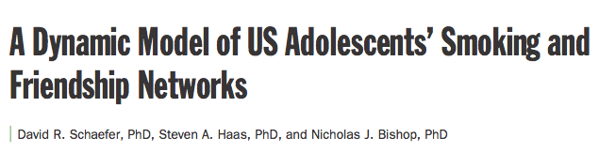
Method
National Longitudinal Study of Adolescent Health (Add Health)
In-school + two in-home surveys, 1994-1996 (3 waves)
Two schools provide most suitable data for longitudinal network modeling; begin with Jefferson High
Students nominated up to 5 male and 5 female friends (directed network)
Friendships coded present (1) or absent (0) for each dyad
SAOM of friendship and smoking change

Slide 36
A Note on Interpreting Coefficients
Helpful to imagine the network function as a logistic regression
Unit of analysis: dyad
Outcome: tie presence (keeping or adding) vs. absence (dissolving or failing to add)
Effects represent how a one-unit change in the statistic affects the log-odds of a tie during a microstep, all else being equal
Some effects interpretable using odds ratios, but
One-unit changes may not be meaningful
All else is rarely equal (e.g., adding a tie affects the outdegree count, at a minimum)
Behavior function specifies how a one-unit change in the statistic affects the log odds of adopting behavior at level z+1 vs. level z

Slide 37
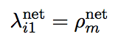
Network function | b |  | SE
Rate | 10.26 | *** | .49
Outdegree | -3.91 | *** | .08
Reciprocity | 1.91 | *** | .09
Transitive triplets | .52 | *** | .04
Popularity | .29 | *** | .04
Extracurric. act. overlap | .28 | *** | .06
Smoke similarity | .68 | *** | .12
Smoke alter | .14 | ** | .05
Smoke ego | -.04 |  | .05
Female similarity | .24 | *** | .04
Female alter | -.11 | * | .05
Female ego | -.04 |  | .05
Age similarity | 1.00 | *** | .13
Age alter | -.01 |  | .03
Age ego | -.04 |  | .03
Delinquency similarity | .15 |  | .08
Delinquency alter | -.04 |  | .04
Delinquency ego | .02 |  | .04
Alcohol similarity | .27 | ** | .10
Alcohol alter | -.03 |  | .03
Alcohol ego | -.03 |  | .04
GPA similarity | .70 | *** | .13
GPA alter | -.05 |  | .04
GPA ego | -.02 |  | .04
Rate: Each actor is given ~10 micro steps in which to make a change to its network
Add a tie, drop a tie, or make no change
Rate
From Schaefer, D.R. S.A. Haas, and N. Bishop. 2012. “A Dynamic Model of US Adolescents’ Smoking and Friendship Networks.” American Journal of Public Health, 102:e12-e18.
Notes:
Fitted Model

Slide 38
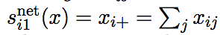
Network function | b |  | SE
Rate | 10.26 | *** | .49
Outdegree | -3.91 | *** | .08
Reciprocity | 1.91 | *** | .09
Transitive triplets | .52 | *** | .04
Popularity | .29 | *** | .04
Extracurric. act. overlap | .28 | *** | .06
Smoke similarity | .68 | *** | .12
Smoke alter | .14 | ** | .05
Smoke ego | -.04 |  | .05
Female similarity | .24 | *** | .04
Female alter | -.11 | * | .05
Female ego | -.04 |  | .05
Age similarity | 1.00 | *** | .13
Age alter | -.01 |  | .03
Age ego | -.04 |  | .03
Delinquency similarity | .15 |  | .08
Delinquency alter | -.04 |  | .04
Delinquency ego | .02 |  | .04
Alcohol similarity | .27 | ** | .10
Alcohol alter | -.03 |  | .03
Alcohol ego | -.03 |  | .04
GPA similarity | .70 | *** | .13
GPA alter | -.05 |  | .04
GPA ego | -.02 |  | .04
Outdegree: The negative sign is typical. It means that ties are unlikely, unless other effects in the model make a positive contribution to the network function.
Odds of adding a tie are .02 times (exp[-3.91]) times the odds of not adding a tie, all else being equal
density
From Schaefer, D.R. S.A. Haas, and N. Bishop. 2012. “A Dynamic Model of US Adolescents’ Smoking and Friendship Networks.” American Journal of Public Health, 102:e12-e18.
Notes:
Fitted Model

Slide 39
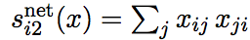
Network function | b |  | SE
Rate | 10.26 | *** | .49
Outdegree | -3.91 | *** | .08
Reciprocity | 1.91 | *** | .09
Transitive triplets | .52 | *** | .04
Popularity | .29 | *** | .04
Extracurric. act. overlap | .28 | *** | .06
Smoke similarity | .68 | *** | .12
Smoke alter | .14 | ** | .05
Smoke ego | -.04 |  | .05
Female similarity | .24 | *** | .04
Female alter | -.11 | * | .05
Female ego | -.04 |  | .05
Age similarity | 1.00 | *** | .13
Age alter | -.01 |  | .03
Age ego | -.04 |  | .03
Delinquency similarity | .15 |  | .08
Delinquency alter | -.04 |  | .04
Delinquency ego | .02 |  | .04
Alcohol similarity | .27 | ** | .10
Alcohol alter | -.03 |  | .03
Alcohol ego | -.03 |  | .04
GPA similarity | .70 | *** | .13
GPA alter | -.05 |  | .04
GPA ego | -.02 |  | .04
Reciprocity: Ties that create a reciprocated tie are more likely to be added or maintained. This effect hovers around 2 in friendship-type network.
Odds of adding/keping a reciprocated tie are 6.7 times (exp[1.91]) times the odds of adding/keeping a non-reciprocated tie, all else being equal
recip
From Schaefer, D.R. S.A. Haas, and N. Bishop. 2012. “A Dynamic Model of US Adolescents’ Smoking and Friendship Networks.” American Journal of Public Health, 102:e12-e18.
Notes:
Fitted Model

Slide 40
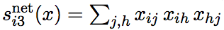
Network function | b |  | SE
Rate | 10.26 | *** | .49
Outdegree | -3.91 | *** | .08
Reciprocity | 1.91 | *** | .09
Transitive triplets | .52 | *** | .04
Popularity | .29 | *** | .04
Extracurric. act. overlap | .28 | *** | .06
Smoke similarity | .68 | *** | .12
Smoke alter | .14 | ** | .05
Smoke ego | -.04 |  | .05
Female similarity | .24 | *** | .04
Female alter | -.11 | * | .05
Female ego | -.04 |  | .05
Age similarity | 1.00 | *** | .13
Age alter | -.01 |  | .03
Age ego | -.04 |  | .03
Delinquency similarity | .15 |  | .08
Delinquency alter | -.04 |  | .04
Delinquency ego | .02 |  | .04
Alcohol similarity | .27 | ** | .10
Alcohol alter | -.03 |  | .03
Alcohol ego | -.03 |  | .04
GPA similarity | .70 | *** | .13
GPA alter | -.05 |  | .04
GPA ego | -.02 |  | .04
Transitive triplets: Ties that create more transitive triads have a greater likelihood.
Should also test interaction with reciprocity (usually negative)
transTrip
From Schaefer, D.R. S.A. Haas, and N. Bishop. 2012. “A Dynamic Model of US Adolescents’ Smoking and Friendship Networks.” American Journal of Public Health, 102:e12-e18.
Notes:
Fitted Model

Slide 41
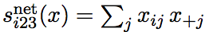
Network function | b |  | SE
Rate | 10.26 | *** | .49
Outdegree | -3.91 | *** | .08
Reciprocity | 1.91 | *** | .09
Transitive triplets | .52 | *** | .04
Popularity | .29 | *** | .04
Extracurric. act. overlap | .28 | *** | .06
Smoke similarity | .68 | *** | .12
Smoke alter | .14 | ** | .05
Smoke ego | -.04 |  | .05
Female similarity | .24 | *** | .04
Female alter | -.11 | * | .05
Female ego | -.04 |  | .05
Age similarity | 1.00 | *** | .13
Age alter | -.01 |  | .03
Age ego | -.04 |  | .03
Delinquency similarity | .15 |  | .08
Delinquency alter | -.04 |  | .04
Delinquency ego | .02 |  | .04
Alcohol similarity | .27 | ** | .10
Alcohol alter | -.03 |  | .03
Alcohol ego | -.03 |  | .04
GPA similarity | .70 | *** | .13
GPA alter | -.05 |  | .04
GPA ego | -.02 |  | .04
Indegree Popularity: Actors with more incoming ties have a greater likelihood of receiving future ties
inPop
From Schaefer, D.R. S.A. Haas, and N. Bishop. 2012. “A Dynamic Model of US Adolescents’ Smoking and Friendship Networks.” American Journal of Public Health, 102:e12-e18.
Notes:
Fitted Model

Slide 42
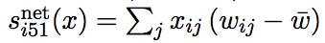
Network function | b |  | SE
Rate | 10.26 | *** | .49
Outdegree | -3.91 | *** | .08
Reciprocity | 1.91 | *** | .09
Transitive triplets | .52 | *** | .04
Popularity | .29 | *** | .04
Extracurric. act. overlap | .28 | *** | .06
Smoke similarity | .68 | *** | .12
Smoke alter | .14 | ** | .05
Smoke ego | -.04 |  | .05
Female similarity | .24 | *** | .04
Female alter | -.11 | * | .05
Female ego | -.04 |  | .05
Age similarity | 1.00 | *** | .13
Age alter | -.01 |  | .03
Age ego | -.04 |  | .03
Delinquency similarity | .15 |  | .08
Delinquency alter | -.04 |  | .04
Delinquency ego | .02 |  | .04
Alcohol similarity | .27 | ** | .10
Alcohol alter | -.03 |  | .03
Alcohol ego | -.03 |  | .04
GPA similarity | .70 | *** | .13
GPA alter | -.05 |  | .04
GPA ego | -.02 |  | .04
Dyadic Covariate: Actors who share an extracurricular activity (coded 1) are more likely to have a friendship tie
X
From Schaefer, D.R. S.A. Haas, and N. Bishop. 2012. “A Dynamic Model of US Adolescents’ Smoking and Friendship Networks.” American Journal of Public Health, 102:e12-e18.
Notes:
Fitted Model

Slide 43
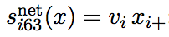
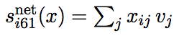
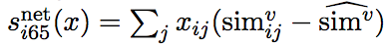
egoX
Network function | b |  | SE
Rate | 10.26 | *** | .49
Outdegree | -3.91 | *** | .08
Reciprocity | 1.91 | *** | .09
Transitive triplets | .52 | *** | .04
Popularity | .29 | *** | .04
Extracurric. act. overlap | .28 | *** | .06
Smoke similarity | .68 | *** | .12
Smoke alter | .14 | ** | .05
Smoke ego | -.04 |  | .05
Female similarity | .24 | *** | .04
Female alter | -.11 | * | .05
Female ego | -.04 |  | .05
Age similarity | 1.00 | *** | .13
Age alter | -.01 |  | .03
Age ego | -.04 |  | .03
Delinquency similarity | .15 |  | .08
Delinquency alter | -.04 |  | .04
Delinquency ego | .02 |  | .04
Alcohol similarity | .27 | ** | .10
Alcohol alter | -.03 |  | .03
Alcohol ego | -.03 |  | .04
GPA similarity | .70 | *** | .13
GPA alter | -.05 |  | .04
GPA ego | -.02 |  | .04
altX
simX
Ties driven by similarity on:
Gender (could use “same” effect)
Age
Alcohol use
GPA
Females less attractive as friends than males.
From Schaefer, D.R. S.A. Haas, and N. Bishop. 2012. “A Dynamic Model of US Adolescents’ Smoking and Friendship Networks.” American Journal of Public Health, 102:e12-e18.
Notes:
Fitted Model

Slide 44
Network function | b |  | SE
Rate | 10.26 | *** | .49
Outdegree | -3.91 | *** | .08
Reciprocity | 1.91 | *** | .09
Transitive triplets | .52 | *** | .04
Popularity | .29 | *** | .04
Extracurric. act. overlap | .28 | *** | .06
Smoke similarity | .68 | *** | .12
Smoke alter | .14 | ** | .05
Smoke ego | -.04 |  | .05
Female similarity | .24 | *** | .04
Female alter | -.11 | * | .05
Female ego | -.04 |  | .05
Age similarity | 1.00 | *** | .13
Age alter | -.01 |  | .03
Age ego | -.04 |  | .03
Delinquency similarity | .15 |  | .08
Delinquency alter | -.04 |  | .04
Delinquency ego | .02 |  | .04
Alcohol similarity | .27 | ** | .10
Alcohol alter | -.03 |  | .03
Alcohol ego | -.03 |  | .04
GPA similarity | .70 | *** | .13
GPA alter | -.05 |  | .04
GPA ego | -.02 |  | .04
Ties driven by similarity on smoking behavior.
Smokers more attractive as friends than non-smokers.
Similarity is an “interaction” between ego and alter, thus interpretation requires considering the main effects
Ego-alter selection: Contributions to network objective function by dyad type
 |  | Alter
 |  | Nonsmoker | Smoker
Ego | Nonsmoker | .25 | -.19
 | Smoker | -.51 | .41
From Schaefer, D.R. S.A. Haas, and N. Bishop. 2012. “A Dynamic Model of US Adolescents’ Smoking and Friendship Networks.” American Journal of Public Health, 102:e12-e18.
Notes:
Fitted Model

Slide 45
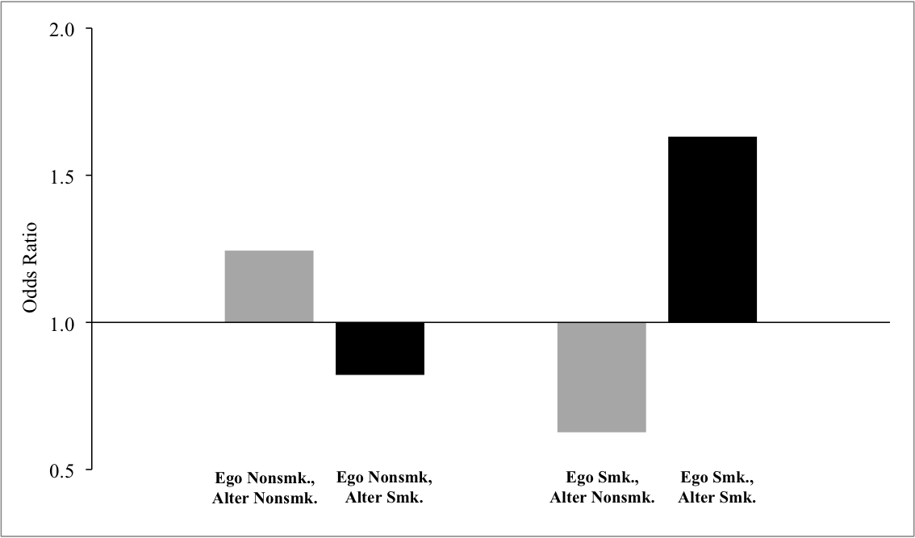
Odds of Friend Selection

Slide 46
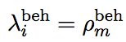
Smoking function | b |  | SE
Rate | 2.06 | *** | .26
Linear shape | -.11 |  | .22
Quadratic shape | 1.17 | *** | .16
Female | .16 |  | .19
Age | -.00 |  | .10
Parent Smoking | .01 |  | .23
Delinquency | .44 | ** | .16
Alcohol | -.10 |  | .14
GPA | -.09 |  | .13
Average similarity | 2.89 | *** | .91
In-degree | -.04 |  | .11
In-degree squared | .00 |  | .01
Rate: Students have around 2 chances on average (micro steps) to change their smoking behavior
Rate
From Schaefer, D.R. S.A. Haas, and N. Bishop. 2012. “A Dynamic Model of US Adolescents’ Smoking and Friendship Networks.” American Journal of Public Health, 102:e12-e18.
Notes:
Fitted Model

Slide 47
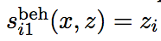
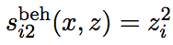
Smoking function | b |  | SE
Rate | 2.06 | *** | .26
Linear shape | -.11 |  | .22
Quadratic shape | 1.17 | *** | .16
Female | .16 |  | .19
Age | -.00 |  | .10
Parent Smoking | .01 |  | .23
Delinquency | .44 | ** | .16
Alcohol | -.10 |  | .14
GPA | -.09 |  | .13
Average similarity | 2.89 | *** | .91
In-degree | -.04 |  | .11
In-degree squared | .00 |  | .01
linear
quad
From Schaefer, D.R. S.A. Haas, and N. Bishop. 2012. “A Dynamic Model of US Adolescents’ Smoking and Friendship Networks.” American Journal of Public Health, 102:e12-e18.
Notes:
Fitted Model

Slide 48
Smoking function | b |  | SE
Rate | 2.06 | *** | .26
Linear shape | -.11 |  | .22
Quadratic shape | 1.17 | *** | .16
Female | .16 |  | .19
Age | -.00 |  | .10
Parent Smoking | .01 |  | .23
Delinquency | .44 | ** | .16
Alcohol | -.10 |  | .14
GPA | -.09 |  | .13
Average similarity | 2.89 | *** | .91
In-degree | -.04 |  | .11
In-degree squared | .00 |  | .01
Smoking (z, M=.9) |  | Linear | Quad
Raw | Centered | b = -.11 | b = 1.17 | Sum
0 | -.90 | .099 | .948 | 1.047
1 | .10 | -.011 | .012 | .001
2 | 1.10 | -.121 | 1.416 | 1.295
+
=
+
=
+
=
Summed Effects
In combination, the linear and quad effects represent the U-shaped smoking distribution.
Kids either don’t smoke or smoke 12+ days/month.
Smoking Level
From Schaefer, D.R. S.A. Haas, and N. Bishop. 2012. “A Dynamic Model of US Adolescents’ Smoking and Friendship Networks.” American Journal of Public Health, 102:e12-e18.
Notes:
Fitted Model

Slide 49
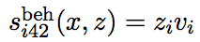
Smoking function | b |  | SE
Rate | 2.06 | *** | .26
Linear shape | -.11 |  | .22
Quadratic shape | 1.17 | *** | .16
Female | .16 |  | .19
Age | -.00 |  | .10
Parent Smoking | .01 |  | .23
Delinquency | .44 | ** | .16
Alcohol | -.10 |  | .14
GPA | -.09 |  | .13
Average similarity | 2.89 | *** | .91
In-degree | -.04 |  | .11
In-degree squared | .00 |  | .01
Ego Covariate: Delinquency leads to higher levels of smoking
effFrom
From Schaefer, D.R. S.A. Haas, and N. Bishop. 2012. “A Dynamic Model of US Adolescents’ Smoking and Friendship Networks.” American Journal of Public Health, 102:e12-e18.
Notes:
Fitted Model

Slide 50
Smoking function | b |  | SE
Rate | 2.06 | *** | .26
Linear shape | -.11 |  | .22
Quadratic shape | 1.17 | *** | .16
Female | .16 |  | .19
Age | -.00 |  | .10
Parent Smoking | .01 |  | .23
Delinquency | .44 | ** | .16
Alcohol | -.10 |  | .14
GPA | -.09 |  | .13
Average similarity | 2.89 | *** | .91
In-degree | -.04 |  | .11
In-degree squared | .00 |  | .01
Average Similarity: Students adopt smoking levels that bring them closer to the average of their friends
avSim
From Schaefer, D.R. S.A. Haas, and N. Bishop. 2012. “A Dynamic Model of US Adolescents’ Smoking and Friendship Networks.” American Journal of Public Health, 102:e12-e18.
Notes:
Fitted Model

Slide 51
Goodness of Fit (GOF)
How well is the estimated model able to reproduce features of the observed data that were not explicitly modeled?
Network
Degree distribution
Geodesic distribution
Triad census
Behavior distribution
Lots of room to improve GOF measures, especially behavior

Slide 52
Cumulative Indegree Distribution
Notes:
New specification of AJPH model

Slide 53
Geodesic Distribution
Notes:
New model specification

Slide 54
Triad Census
Notes:
New model specification

Slide 55
Smoking Distribution
Notes:
New model specification

Slide 56
4. Extensions & Miscellany

Slide 57
Extensions to Basic Model
interactions
event history outcomes
multiple behaviors
multiple network options
valued ties
multilevel networks
two mode networks
increase vs. decrease in ties and/or behavior
time heterogeneity
simulations (test interventions)
ML, Bayes estimation
Notes:
New model specification

Slide 58

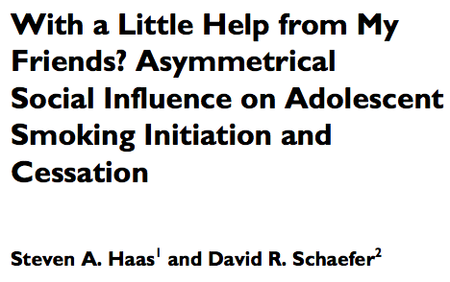
Asymmetric Peer Influence
Implicit assumption that effects work the same for:
Tie formation vs. dissolution
Behavior increase vs. decrease
Behavior change constraint unrealistic for smoking
Physical/psychological dependence, social learning
Relax this assumption and separate behavior function into:
Creation function: only considers increases
Maintenance function: only considers decreases

Slide 59
Asymmetric Peer Influence
Implicit assumption that effects work the same for:
Tie formation vs. dissolution
Behavior increase vs. decrease
Unrealistic for smoking
Physical/psychological dependence, social learning
Easy to relax this assumption
Separate behavior objective function into:
Creation function: only considers increases
Maintenance function: only considers decreases
Could make similar distinction in the network function

Slide 60
Contributions to the Smoking Function
Smoking level with greatest contribution most likely to be adopted (with caveat that actors can only move behavior one level during a given micro step)
Ego is currently a moderate smoker (1)
Nonsmoking Alters
Smoking Alters
Contribution
Contribution
J = Jefferson High School
S = Sunshine High School
Prospective
Smoking
Prospective
Smoking
From Haas, Steven A. and David R. Schaefer. 2014. “With a Little Help from My Friends? Asymmetrical Social Influence on Adolescent Smoking Initiation and Cessation.” Journal of Health and Social Behavior, 55:126-143.
Notes:
Implication: students don’t begin smoking unless friends do. Students may cease smoking even if friends continue smoking.

Slide 61
Contributions, Cont.
Ego Current Smoking Status
Nonsmoking (0) | Moderate (1) | Smoking (2)
Nonsmoking (0) | Friends’ Current Smoking Status
Moderate (1)
Smoking (2)
Smoking level with greatest predicted contribution is most likely to be adopted
Predicted Contribution
J = Jefferson High School
S = Sunshine High School
From Haas, Steven A. and David R. Schaefer. 2014. “With a Little Help from My Friends? Asymmetrical Social Influence on Adolescent Smoking Initiation and Cessation.” Journal of Health and Social Behavior, 55:126-143.
Prospective Smoking Level
Notes:
Implication: students don’t begin smoking unless friends do. Students may cease smoking even if friends continue smoking.

Slide 62
SIENA as an Agent-Based Model
Model fitting uses a simulation algorithm, making computational experiments a natural extension
Decision rules are grounded in empirical estimates
Useful to evaluate goodness-of-fit, decompose network-behavior associations, and evaluate interventions
Fit model to empirical data (optional)
Simulate network evolution using estimated parameters or manipulations of them
Can also manipulate initial conditions (e.g., network structure, behavior distribution, etc.)
Measure simulated network/behavior properties of interest

Slide 63
Decomposing Network Homogeneity
How much network homogeneity on smoking is due to selection vs. influence?
Systematically set selection and influence parameters to zero and simulate network-behavior co-evolution (see Steglich et al. 2010)
Source | Selection (%) | Influence (%) | Sample
Schaefer et al. 2012 | 40 | 34 | U.S.
Mercken et al. 2009 | 17-47 | 6-23 | Europe (6 countries)
Mercken et al. 2010 | 31-46 | 15-22 | Finland
Steglich et al. 2010 | 25-34 | 20-37 | Scotland

Slide 64

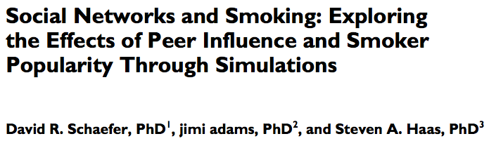
Evaluating Interventions: How do smoking/friendship dynamics affect smoking prevalence?
Manipulate model parameters related to key “intervention levers”
Peer influence
Smoker popularity
Remaining model parameters from fitted model
Initial conditions = observed wave 1 data

Slide 65
Manipulations
Peer influence (avSim): observed b = 2.89
Manipulated b = 0, 1, 2, 3, 4, 5, 6
Absent to strong (rarely observe negative PI)
Smoker popularity (altX): observed b = .14
Manipulated b = -.45, -.3, -.15, 0, .15, .3, .45, .6, .75
Unpopular…absent…popular
1,000 iterations per condition
Remaining parameters same as fitted model
Initial conditions: observed wave 1 data

Slide 66
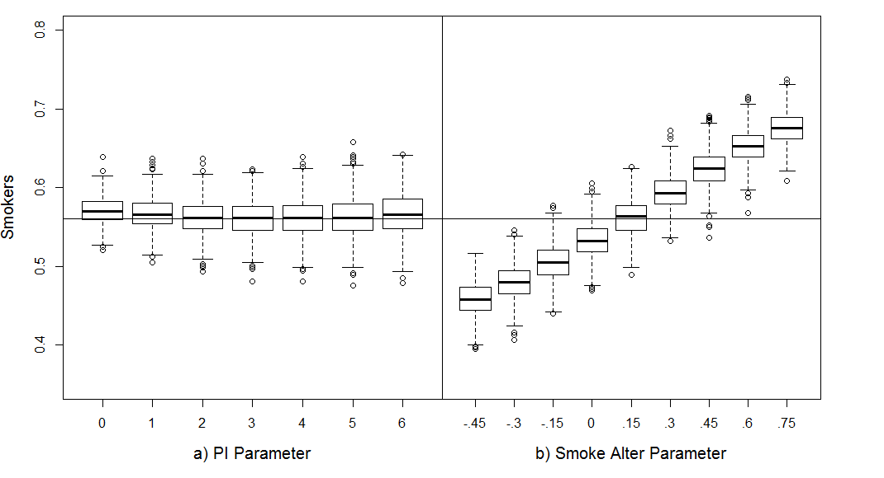
Results of Manipulating Peer Influence (PI) and Smoking-based Popularity (smoke alter)
Joint Manipulation
Independent Manipulations
Stronger peer influence increases smoking prevalence, but only when smokers are popular (negative effects when smokers unpopular)
Schaefer DR, adams j, Haas SA. 2013. Social Networks
and Smoking: Exploring the Effects of Peer Influence
and Smoker Popularity through Simulations.
Health Education & Behavior, 40(S1):24-32.
Notes:
Peer influence affects prevalence, direction depends upon whether smokers are popular or unpopular.
Popularity affects prevalence, but only when PI is present.

Slide 67

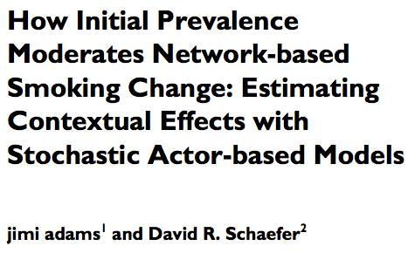
Context Effects:
We’ve only been considering limited school contexts
Jefferson High is somewhat atypical

Slide 68
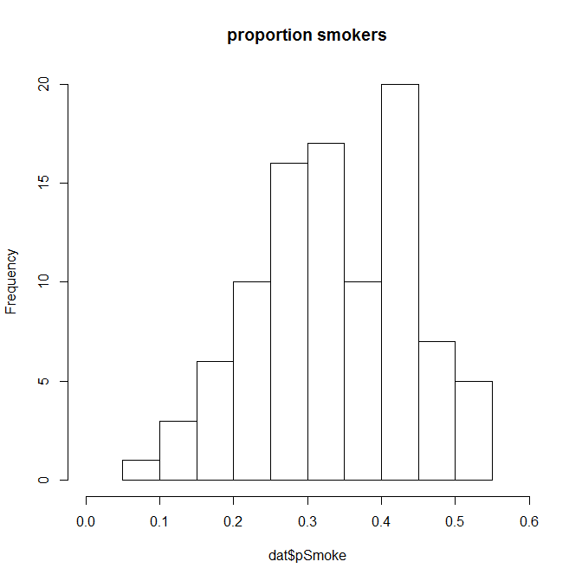
Smoking Prevalence across 95 Add Health schools (proportion of students who smoked in past 12 months)
Jefferson High
Smoking Prevalence
Notes:
Not clear how generalizable the simulation results are.

Slide 69
Context Effects:
We’ve only been considering limited school contexts
Jefferson High is somewhat atypical
How do the effects of these manipulations depend upon context?
Perform the same computational experiment, but in schools with higher or lower prevalence

Slide 70
Vary Initial Conditions
Key factor: initial smoking prevalence
But how to distribute smoking, given its association with network structure?
Associations depend on smoking prevalence
.25 | .35 | .45 | .55 | .65 | .75
Prevalence

Slide 71
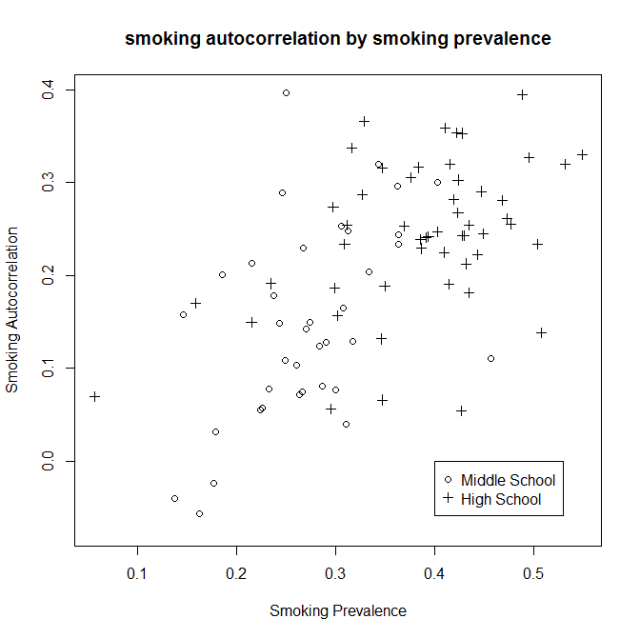
Notes:
More clustering in higher prevalence schools

Slide 72
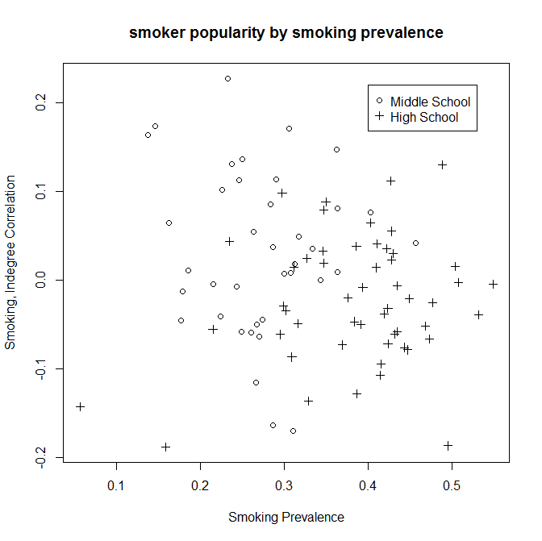
Notes:
Middle school: smokers less popular in higher prevalence schools
High school: smokers more popular in higher prevalence schools

Slide 73
Prevalence Manipulation
Randomly assign smoking values
Model-based: Use ERGM to simulate initial networks with specified network properties
Network/smoking associations
Autocorrelation on factors related to smoking (sex, age, alcohol, smoking)
Retain networks matching observed on density, autocorrelation, and smoker popularity
Empirically-based: use each observed Add Health school
Maintains all associations
Notes:
When smokers are unpopular, increasing PI decreases prevalence in all but highest smoking contexts
When smokers are popular, increasing PI magnifies existing trends: low-prevalence contexts exhibit decreases while high-prevalence contexts exhibit increases.
Observe that high/low cutoff shifts with smoker popularity. Implication: if smokers are popular then even low prevalence schools can experience increases via PI.

Slide 74
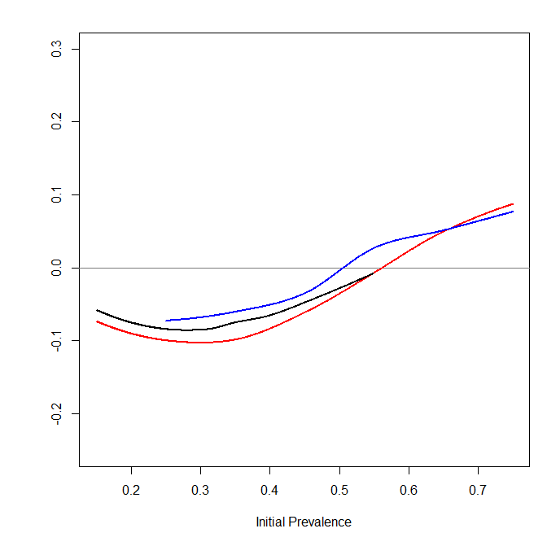
Results: Observed Parameter Estimates,
Initial Prevalence Manipulation
Empirically-Based
Model-Based
Random
Observed Estimates
Smoker Popularity
b = .2
Peer Influence
b = 3
Change in Prevalence
Notes:
Using model parameters estimated from observed school (Black=Observed, Red=Random, Blue=ERGM)

Slide 75
Results: 95 Add Health Schools as Initial Conditions
Observed Estimates
Smoker Popularity
b = .2
Peer Influence
b = 3

Slide 76
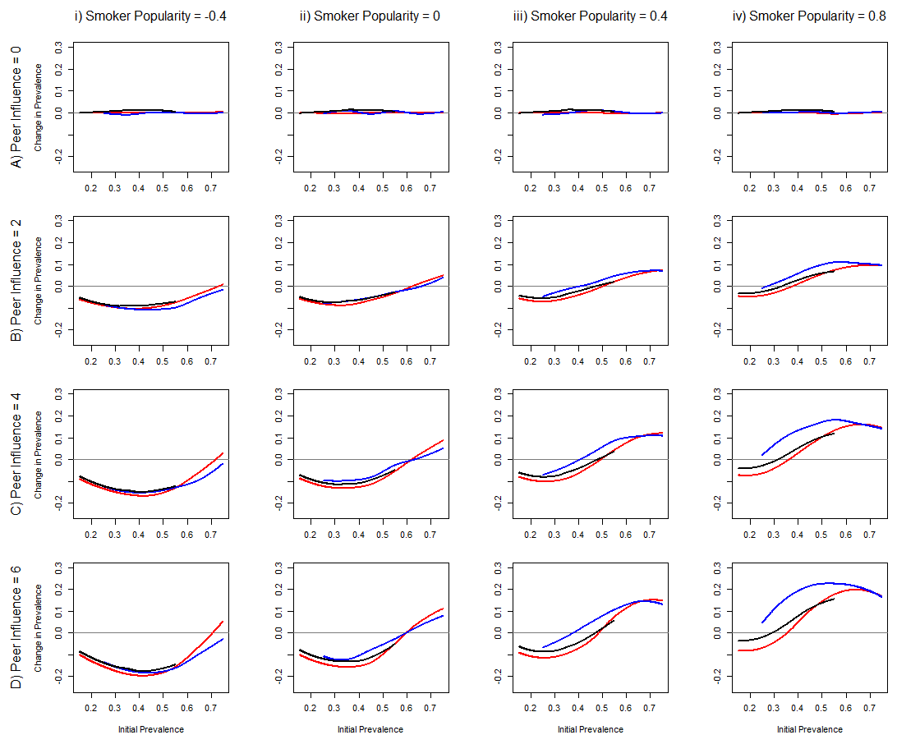
Smoking Distribution: Empirically-Based, Model-Based, Random
Notes:
When smokers are unpopular, increasing PI decreases prevalence in all but highest smoking contexts
When smokers are popular, increasing PI magnifies existing trends: low-prevalence contexts exhibit decreases while high-prevalence contexts exhibit increases.
Observe that high/low cutoff shifts with smoker popularity. Implication: if smokers are popular then even low prevalence schools can experience increases via PI.

Slide 77
Contrasting Contexts
25% Initial Smokers | 75% Initial Smokers
Notes:
Results with random smoking distribution.
In low prevalence context, peer influence is a good things. Serves a protective function.
In high prevalence context, peer influence leads to trouble.

Slide 78
SIENA Assumptions
Ties are more or less enduring states
Plausible for friendship or collaborations
Not useful for “event” data (e.g. phone calls)
Change occurs in continuous time
Markov process: future state only a function of current state
No lagged effects or “grudges”
Actors control outgoing ties and behavior
One change at a time
No coordinated or simultaneous changes

Slide 79
Missing Data
Up to 10% probably ok, more than 20% likely a problem
Endogenous network & behavior imputation
Missing values at t₀ set to 0 (network) or mode (behavior)
Missing values at t₁₊ imputed with last valid value if possible, otherwise 0
Covariates imputed with the mean
Other values can be specified
Imputed values are treated as non-informative, thus not used in calculating target statistics
Convergence and fit are determined based only upon observed cases

Slide 80

Good Sources of Information
RSiena manual
Snijders, van de Bunt & Steglich, 2010
Steglich, Snijders & Pearson, 2010
Tom Snijders’ SIENA website
www.stats.ox.ac.uk/siena/
Workshops
Scripts
Applications in the literature
Latest version of RSiena
Link to stocnet listserv – important updates announced here
“Siena_algorithms.pdf”
Notes:
New model specification

Slide 81
End of Lecture

Slide 82
SAOM Lab
If you haven’t done so already:
Download the script from box
Install the RSiena library
Type: install.packages("RSiena”)

Slide 83
Data structures possible for T>1 time points
(SIENA data creation functions in parentheses)
A model can have multiple instances of each type (even dependent networks and behaviors)
 | Exogenous |  | Endogenous
Data Type | Single time point | Multiple time points (1 to T-1) | Multiple time points (1 to T)
Individual Attribute | Constant Covariate (coCovar) | Changing Covariate (varCovar) | Dependent Behavior (sienaDependent, type=‘behavior’)
Network* | Dyadic Covariate (coDyadCovar) | Changing Dyadic Covariate (varDyadCovar) | Dependent Network (sienaDependent, type=‘oneMode’)
* Bipartite networks also possible

Slide 84
Data Structure: Dependent Network
One mode or two mode network with at least two observations, each represented as a matrix
Ties coded 0, 1, 10 (structural 0), 11 (structural 1), or NA
For each “period” between adjacent waves, stability measured by the Jaccard coefficient should be at least .25
Ties persisted / (ties formed + ties dissolved + ties persisted)
“Complete network data” all actors w/in bounded setting
Some turnover in set of actors allowed but same actors in the data for each wave (even if not observed during wave)
See manual for how to deal with composition change
Recommended N: 30-2000

Slide 85
Additional Data Structures
Dependent behaviors
Time-varying attributes used as dependent variable(s)
Coded as integer (e.g., 1-10)
Last time point is used
Changing actor covariates
Time-varying attributes used as independent variables
Last time point not used (only applicable for 3+ waves)
Constant covariates
Ex: age, sex, race/ethnicity, behavior
Dyadic covariates
Ex: settings that drive contact
NOTE: Covariates are centered by default

Slide 86
TERGM Dependence: Mutuality Example
Time 1 | Time 2 | Δ Mutuality Count | But… | SIENA Treatment During Estimation
 |  | + 2 | Both explained by stability term | Counts as keeping 2
 |  | + 2 | One explained by stability term | Counts as 2 (add 1 & ~keep 1)
NULL |  | + 2 | Both count | Counts as 2, only 1 via recip. (2 steps)
 |  | + 0 | Not reciprocity? | Counts as 0, but could add + drop
 |  | + 0 | +1 mutual tie -1 mutual tie | Model respects loss of 1
 | NULL | + 0 | Lost 2! | Model respects loss of 2 (2 steps)
Assumes ERGM with edges, stability, and mutuality terms

